Slide 1

A Web Based Bengali News Corpus for Development of Bangla POS Tagging
Supervised By – Mr. Fahad Ahmed (Asst. Prof), AIUB Zarin Tasnim, Mehedi Hassan Sunny, Dipanjan Banik

Slide 2
Introduction

Slide 3
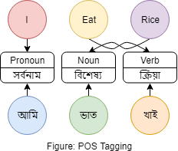
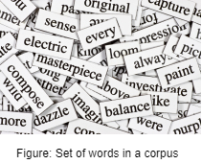
What is POS Tag
POS tagging stands for Part-of-Speech
Part-of-Speech explains how a word is used in a sentence
There are several grammatical categories in a POS tagger
A POS tag is a special label assigned to each word in a text corpus
POS tags are used in corpus searches and in text analysis tools and algorithms
A corpus is a large collection of texts which is usually labelled with information about part-of-speech and grammatical category
Part-of-speech categorization is taught in school-age children to construct a meaningful sentence
POS tagging is used in natural language processing (NLP) which is mainly use for machine learning
POS tags are extremely useful since they provide linguistic signal on how a word is being used within the scope of a phrase, sentence, or document

Slide 4

Structure of a POS tag
A POS consists different types of grammatical categories such as tense, number etc.
All kind of POS tags have a several different tagset and different language tagsets are typically different from each other
Grammatical categories are subdomain to POS tagset
Tags are useful for building parse trees which shows the relations between words
Some set of specific rules, conventions, and principles which dictate how phase, clause and words combined into sentences
There are some lexical categories which words are assigned based on their syntactic context and role
The most common part-of-speech are: noun(বিশেষ্য), pronoun(সর্বনাম), adjective(বিশেষণ), verb(ক্রিয়া), adverb(ক্রিয়া বিশেষন), preposition(অব্যয়)
Its essential for building lemma which are used to reduce a word to its root form

Slide 5
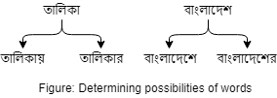
Structure of a POS tag (continue..)
Lexical resources of word dictionaries that cover the whole possibilities of the language and their possible POSes
After sentence tagged by appropitate POS a language-specific grammar applied for understanding the correct combinations of words
Finally a algorithm is applied to detect the most probable parsing for a given sentence, and then the POSes corresponding to that parsing are assigned to each word
This approach requires a great quantity of linguistic data and a large set of corpus for more accurate result

Slide 6
Research Question

Slide 7
Structure of a POS tag (continue..)
What can be used to make Word Sense Disambiguation for Bangla Language sentences
How can Bangla POS tagging be made more domain specific

Slide 8
Working Procedure

Slide 9
Data source selection
We focused on the online newspaper based corpus which have a nearly infinite resource of bengali news
We narrow down our data collection to sports section of particular newspaper
Why sports?... Because we thought that our country is sports oriented country and its very much easier to find any kind of news that is related to cricket, football etc.
We have determined to collect 3 months data and we have selected Ittefaq(ittefaq.com.bd) for our main data source
After selection of data source a python based web crawler used for collect the data and we stored our data directly into database

Slide 10
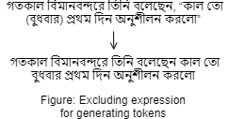
Data collection
After crawling from web source we have gathered 28531 meaningful sentences and which generates total 300138 word token
We have excluded the commas[,], brackets[()] and quotation[“ ”] from every sentences to pre processed our corpus
For lexicon development pre processed raw text helps us to generate the dictionary of bengali words

Slide 11
Data annotation
After collection of data we decided to work on data annotation which is done by a online survey
We choose the survey participants who are studying in colleges or varsity students and a few bengali teachers as well,
Our data annotation was done by two phase, first phase is done by student and second phase annotation done by manually along with some teachers who are expert in bengali language and some of them also are in teaching profession
Expert judged annotated data were then manually entered into the database for our final working procedure

Slide 12
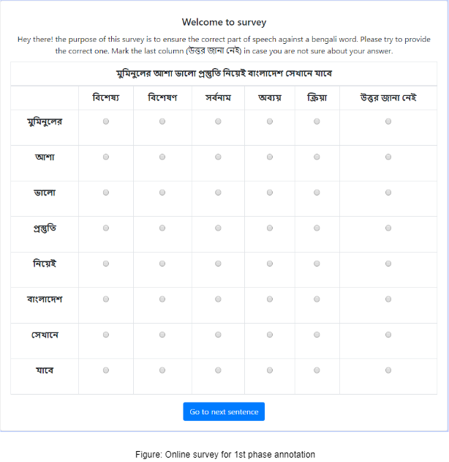
Data annotation (continue..)

Slide 13
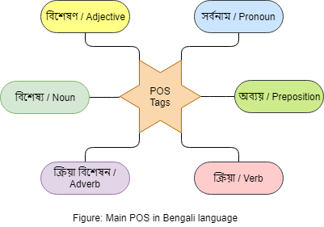
POS tagging definition
We have used total 7 POS tag to identify a word and 6 of them are mostly used parts-of-speech in bengali grammar and 1 POS tag used for unidentified words
Unidentified words are later checked again with a supervised predefined dataset for re-tagging the words

Slide 14
Steps to goal
The annotated words which were justified by the justifiers are listed differently as training set.
A portion of data was taken from that particular data set to apply lexicon analysis.
The next step was to find predicted words against a word that is already annotated and marked as correct by the justifiers.
The next step was to put the predicted words to their respected table
This process continues every time POS tag was found against a word that was marked as correct.
Then a test sentence was applied direct from the data source to check whether the tag is correct or not.
Then it was time to change the sentence with some similar word that may occur in other scenarios and test the sentence.

Slide 15
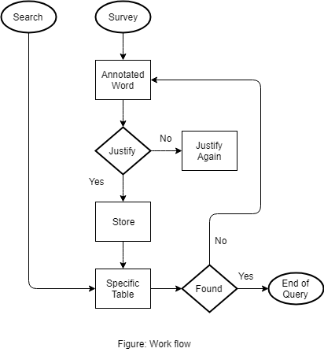
Steps to goal (continue..)

Slide 16
Findings & Limitations

Slide 17
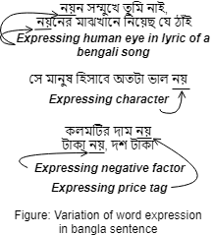
Findings
It is possible to convert bengali words into corresponding english words and then find the POS tags but in general every language have own set of grammar rules and for this case it may occur the wrong output result
Word variation in bengali grammar are typically difficult to identify and we also identified that same word carry different meaning in same sentence which complex the detection of POS tag

Slide 18
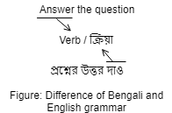
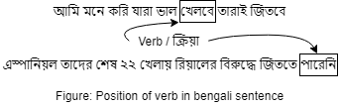
Findings (continue..)
Most of the cases we found that at the end of a bangla sentence a verb occurred
It is a continuous process as many new words is getting introduced in the field of sports. As an example a few days ago we were not familiar with the term “T20(টি-টোয়েন্টি)”. Gradually we got used to it. Recently we have discovered a new term called “T10(টি-টেন)”. So as the format of sports changes so as the words

Slide 19

Findings (continue..)
The sports domain have several limitation and one of the main thing is a sentence uses several foreign words and which is typically identify as noun and it is also difficult to find rest of the POS tags
In some sentence we found noun rather than any other POS tags like verb, pronoun etc.

Slide 20
Findings (continue..)
The percentage of noun tags is higher in the sports domain
*Sample size 1550
Tag set | Percentage
Noun | 61.94
Verb | 15.94
Adjective | 7.61
Preposition | 1.35
Adverb | 4.71
Pronoun | 6.39
Undefined | 2.06

Slide 21
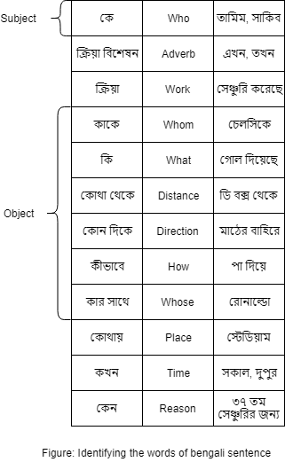
Findings (continue..)
There are some keywords which answers result in POS tag

Slide 22
Limitations
It's very difficult to find a reliable source of raw bengali text and modern linguistics people often mix up english words in bangla sentences
Novels and fiction books are the good source of reliable data but there is lack of online resources to find these types of dataset
Language is human based, so if there are human errors the ultimate result will turn into failure. Though we have checked the results with our experts from different well known institutions but there is a slight chance of error if they made a mistake
The justification was done by some mentors from different reputed colleges and universities. So there might be some human error as they may unable to annotate the correct tag form.

Slide 23
Question & Answer

